Slide 2
Genetic code/ Triplet code
There are 4 bases A,U,G, C
For a triplet code, how many combinations are possible?
Protein is made of 20 different amino acids

Slide 3
Types of mutations
Substitution- Exchanges one base for another
Insertion- Insertion of extra base pairs
Deletion- Deletion of a base pair or sections of DNA
Frame shift- Insertions or deletions resulting in altered proteins due to a shift in the frames.
There are other types but the above ones are the basic.

Slide 4
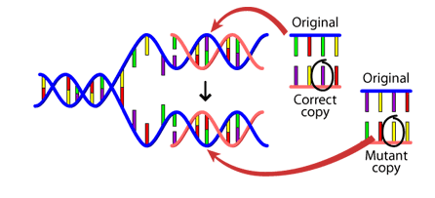

Causes of mutation
DNA fails to copy accurately
External influences can create mutations- harmful chemicals and radiation
Cell can repair- But is not perfect

Slide 5
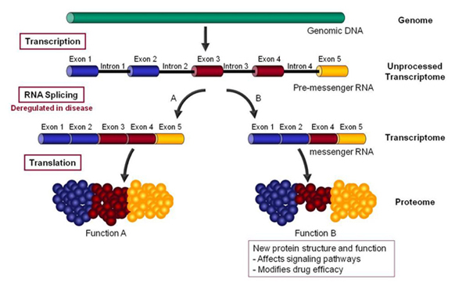
Hutchinson-Gilford Progeria Syndrome – a disease of accelerated aging due to Alternative Splicing
http://www.anti-agingfirewalls.com/2016/02/04/hutchinson-gilford-progeria-syndrome-a-disease-of-accelerated-aging-due-to-alternative-splicing/

Slide 6
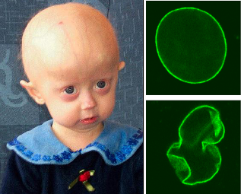
“HGPS is a major clue to solving the “puzzle of aging” and the molecular mechanisms here are relevant to normal aging. ”
https://en.wikipedia.org/wiki/Progeria

Slide 7
Databases of Biological Data
General Repositories
GenBank - USA
EMBL - Europe: http://www.ebi.ac.uk/embl/
Specialized by data type
NCBI Trace Archive - raw reads from sequencing machines
SwissProt - curated protein information: http://www.expasy.org
KEGG - metabolic pathways: http://www.genome.jp/kegg/
Gene Expression Omnibus (GEO) - gene expression
PDB - protein structures
Specialized by organism
ZFIN - zebrafish
SGD - yeast
WormBase - c. elegans
FlyBase - fruit fly

Slide 8
Primary Database
In bioinformatics, databases are often categorised as primary or secondary .
Primary databases are populated with
experimentally derived data such as nucleotide sequence, protein sequence or macromolecular structure.
Experimental results are submitted directly into the database by researchers, and the data are essentially archival in nature.
Once given a database accession number, the data in primary databases are never changed: they form part of the scientific record.

Slide 9
Secondary Database
Comprise data derived from the results of analysing primary data.
Secondary databases often draw upon information from numerous sources, including other databases (primary and secondary), controlled vocabularies and the scientific literature. They are highly curated, often using a complex combination of computational algorithms and manual analysis and interpretation to derive new knowledge from the public record of science.
Secondary databases have become the molecular biologist’s reference library over the past decade or so, providing a wealth of (often daunting) information on just about any gene or gene product that has been investigated by the research community. The potential for mining this information to make new discoveries is vast.

Slide 10
Genbank
https://www.ncbi.nlm.nih.gov/genbank/statistics/
First genome sequenced in 1995
(the bacteria H. influenzae with a
genome of 1,830,140 letters).

Slide 11
Genbank website

Slide 12
Worksheet - example
Databases

